Slide 1



FACIAL EMOTION RECOGNITION
M JAYESH - CB.SC.U4AIE24128
M RAKESH - CB.SC.U4AIE24134
CH VIRINCHI SAI - CB.SC.U4AIE24158
K JATIN CHANDRA GUPTA - CB.SC.U4AIE24162

Slide 2
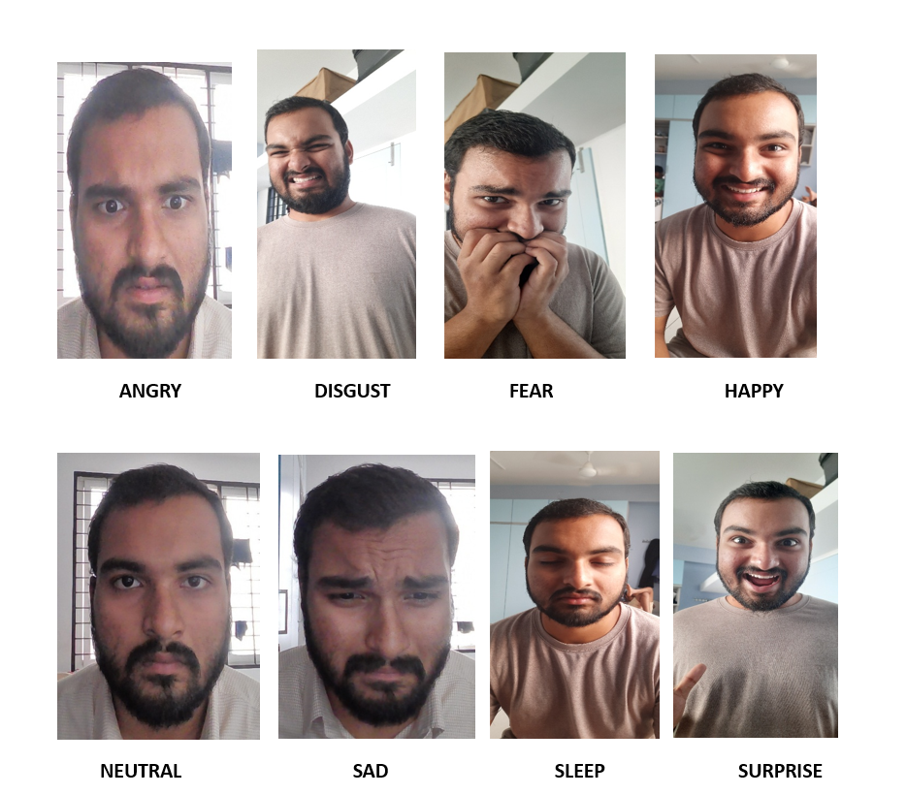
INTRODUCTION
Facial Emotion Recognition (FER) is a computer vision technique that identifies human emotions based on facial expressions. By training on labeled datasets, the model learns to classify emotions such as happy, sad, angry, and more. This project focuses on building a CNN-based model to accurately detect 8 emotions, including sleep, for applications in healthcare, security, and drowsiness detection.

Slide 3
OBJECTIVES
To Develop a Deep Learning:
  Build a CNN model capable of accurately classifying facial expressions into 8 emotion categories: Angry, Disgust, Fear, Happy, Neutral, Sad, Sleep, and Surprise.
Enhance Emotion Recognition Accuracy:
  Implement data augmentation and optimization techniques to improve classification performance.
1
2
3
Integrate Sleep Detection:
  Introduce a ‘Sleep’ class to detect drowsiness in real-time.

Slide 4
Problem Statement:
  Facial emotion recognition is crucial for applications like assistive technology for the visually impaired and driver drowsiness detection. This project aims to develop a CNN-based model to classify emotions, including a ‘Sleep’ class, for enhanced real-time monitoring and safety applications.
Why Deep Learning?
    Deep Learning, particularly CNNs, is the best approach for facial emotion recognition due to its high accuracy.
    Automatically extracts relevant features from raw image data.
    Handles Large Datasets Efficiently
    Supports real-time applications and deployment.
02

Slide 5
METHODOLOGY OVERVIEW
Step 1: Data Collection and Preprocessing
Step 2: Model Architecture Design
Step 3: Model Compilation and Training
Step 4: Model Evaluation
Step 5: Visualization and Analysis
Step 6: Model Saving and Deployment
Step 7: Real-Time Testing

Slide 6
DATA PREPROCESSING
Data Augmentation
  To improve model generalization and prevent overfitting, we apply data augmentation using ImageDataGenerator in TensorFlow.
    Rescaling: Normalize pixel values to [0, 1].
    Rotation: Simulates different face angles.
    Shear Transformation: Slightly distorts images.
    Zooming: Creates variations in image size
    Horizontal Flip: Mirroring images.
    Fill Mode: Fills gaps created by transformations.
Data Loading
  Training Data:
    Convert images to grayscale (48×48) for uniformity.
  Validation Data:
    Loaded with the same preprocessing as training data, but without augmentation, ensuring it remains unaltered for unbiased evaluation.

Slide 7
MODEL ARCHITECTURE
  Input Layer
    Accepts 48×48 grayscale images (input_shape=(48,48,1))
  Convolution & Pooling Layers
    Conv2D(32, 3×3, ReLU) → Extracts low-level features
    Conv2D(64, 3×3, ReLU) → Detects patterns
    MaxPooling2D(2×2) → Reduces spatial size
    Dropout(0.1) → Prevents overfitting
  Deeper Feature Extraction
    Conv2D(128, 3×3, ReLU) → Captures complex patterns
    MaxPooling2D(2×2)
    Dropout(0.1)
    Conv2D(256, 3×3, ReLU) → Further deep feature learning
    MaxPooling2D(2×2)
    Dropout(0.1)
  Fully Connected Layers
    Flatten() → Converts feature maps into a 1D vector
    Dense(512, ReLU) → High-level feature learning
    Dropout(0.2)
  Output Layer
    Dense(8, Softmax) → Classifies emotions into 8 categories

Slide 8
MODEL TRAINING
Training Process
  Data Loading → Load augmented training data and unaltered validation data.
  Forward Propagation → Images pass through CNN layers to extract features.
  Loss Calculation → Model computes error using categorical crossentropy.
  Backward Propagation → Weights update using Adam optimizer to minimize loss.
  Callbacks:
    EarlyStopping: Monitors validation loss and stops training if no improvement for 10 epochs.
    ModelCheckpoint: Saves the best model based on validation accuracy.
Model Evaluation
Evaluation Metrics
  Validation Loss: Measures model performance on unseen data.
  Validation Accuracy: Percentage of correctly classified validation images.

Slide 9
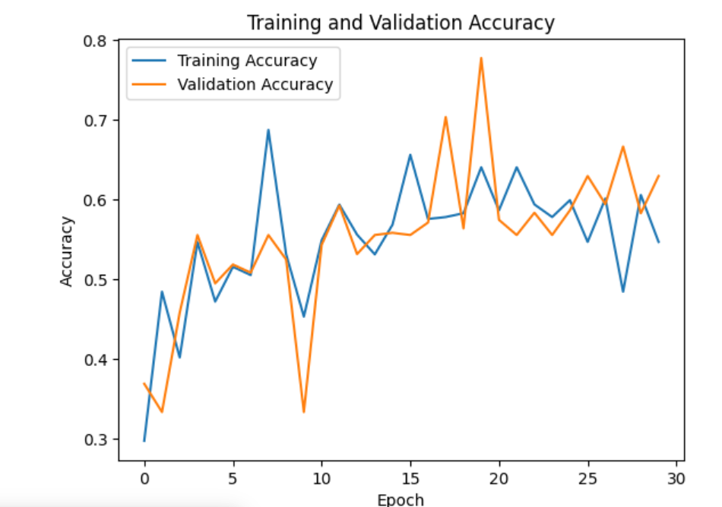
VISUALIZATION
Plots
  Training vs. Validation Accuracy:
    Shows how accuracy improves over epochs.

Slide 10
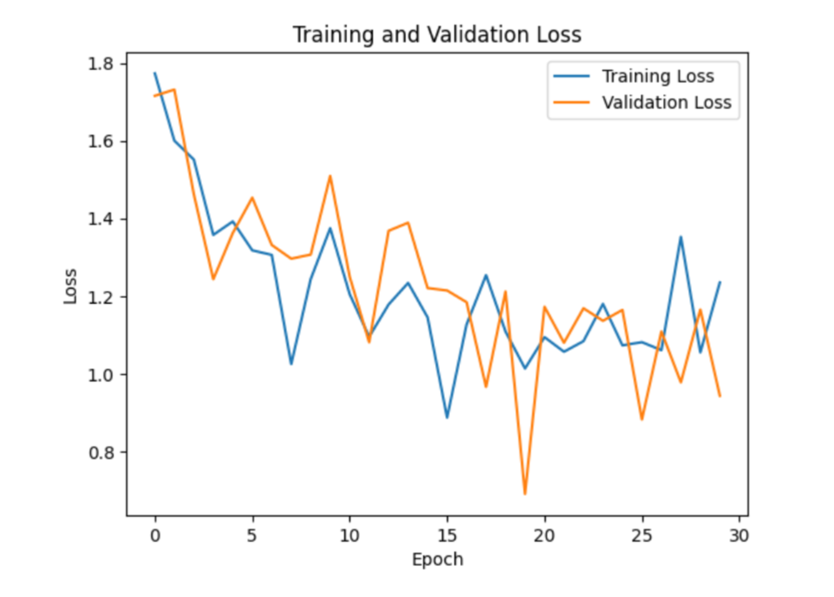
VISUALIZATION
Plots
  Training vs. Validation Loss:
    Shows how loss decreases over epochs.

Slide 11
MODEL SAVING AND DEPLOYMENT
Saving the Model
  Purpose: Save the trained model for future use, avoiding the need to retrain.
  File Format:
    Saved as model_file_with_sleep.keras.
    Best model saved as best_model_with_sleep.keras using ModelCheckpoint.
Deployment
  Real-Time Applications:
    The model can be integrated into systems that require real-time emotion recognition.
Example Use Cases
  Driver Drowsiness Detection
  Human-Computer Interaction
  Healthcare
  Security and Surveillance

Slide 12
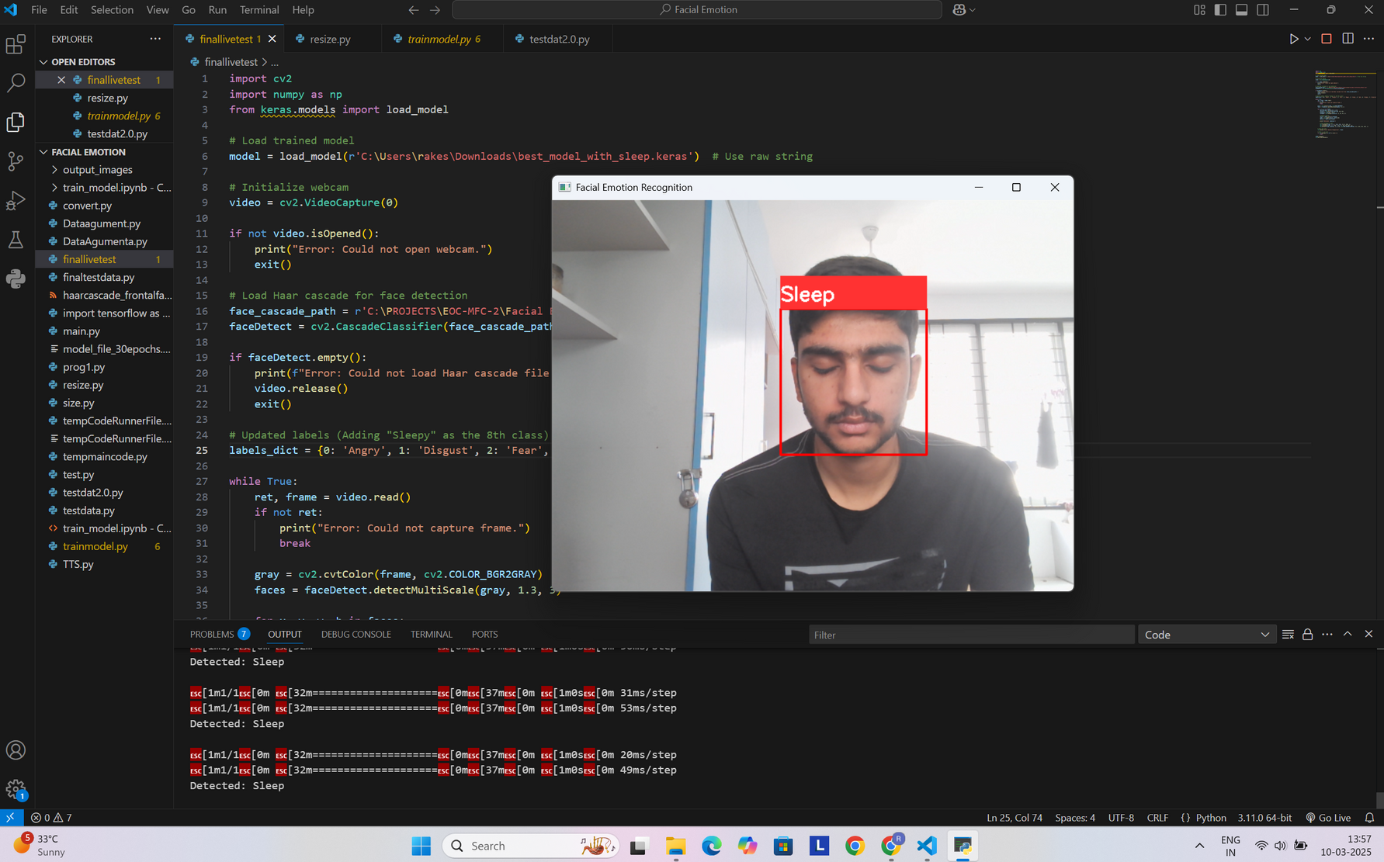
LIVE TEST

Slide 13
CHALLENGES FACED
Dataset Issues
Problem:
  Difficulty in creating a high-quality dataset for the Sleep class.
  Loss of image quality when resizing images to (48, 48).
Impact:
  Reduced model performance on the Sleep class due to poor-quality images.
  Potential bias in the dataset affecting overall accuracy.
Class Imbalance
Problem:
  Some emotion classes (e.g., Disgust, Sleep) had fewer samples compared to others (e.g., Happy, Sad).
Impact:
  The model may be biased toward classes with more samples, leading to lower accuracy for a few classes.

Slide 14
FUTURE WORK
  Improve Dataset Quality
    Plan:
      Use advanced image preprocessing techniques to minimize quality loss during resizing.
    Expected Outcome:
      Better representation of the Sleep class, leading to improved model performance.
  Enhance Model Accuracy
    Plan:
      Retrain the model with an improved dataset.
    Expected Outcome:
      Higher accuracy than all models we trained.
  Integrate Audio Feedback
    Plan:
      Add an audio feedback feature to provide real-time emotion predictions.
      For example, the system could say, "He looks happy!" or "He seems tired."
    Expected Outcome:
      Enhanced user experience, especially for visually impaired users.
  Real-Time Deployment
    Plan:
      Deploy the model in real-time applications.
    Expected Outcome:
      A fully functional emotion recognition system for real-world use.

Slide 15
THANK YOU

